Slide 1

Attendee User Guide
ACMS 53rd Annual Meeting
May 5 – 9, 2021

Slide 2

Access
You can enter the event beginning on May 5, 2021.
As an attendee, you will be able to enjoy a unique, interactive learning experience from the comfort and convenience of your home or office.
You can find everything you need to access the event in the Registration Confirmation email you received upon registration.
To make sure your computer, internet connection, and sound are ready to go, take a moment to test your system or device in advance.
Notes:
OVERVIEW
How to access the event.

Slide 3
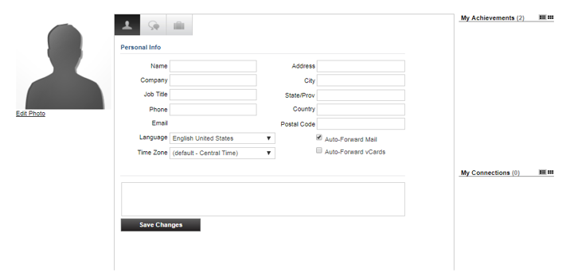

Your Profile
The Profile is where you can customize your personal information, access documents and view your communication activity.
To edit your profile, go to Help and click “Profile”. Your profile contains your name and several other fields that you may have filled out upon registering.
You may choose an image to help identity yourself during the event (select from a list of stock images or upload your own photo). Filling out your profile completely and accurately will help you while networking with attendees in the event.
The briefcase is located within your profile under the third tab. This is where you may retrieve documents and links that you have saved from the Resource Center, sponsor spaces or presentations.

Slide 4
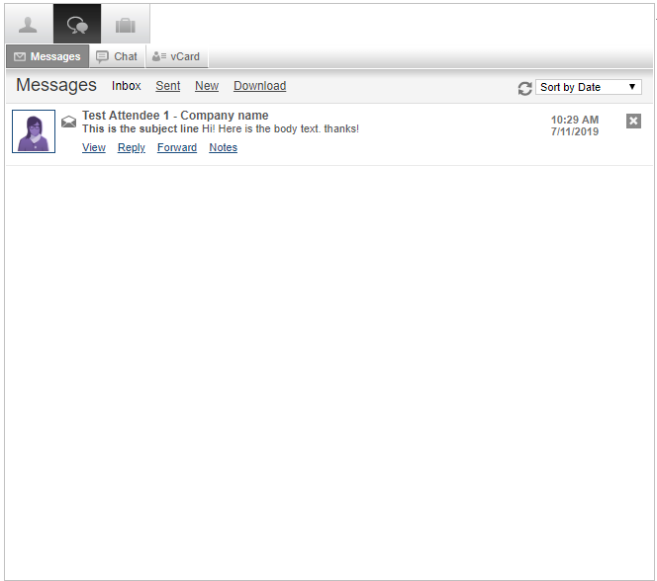
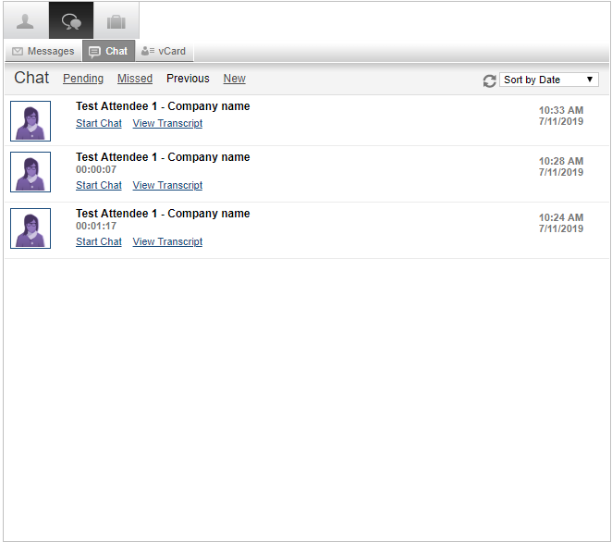
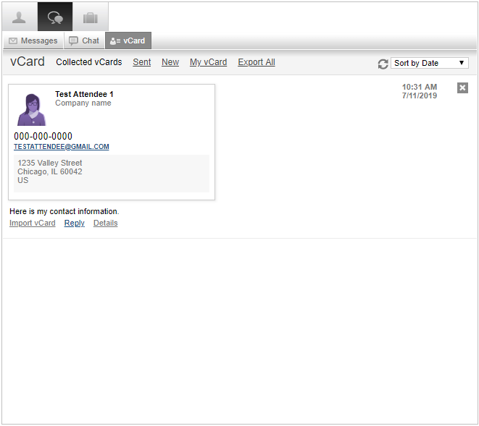
Communication Center
If you receive an email, vCard, chat request or announcement, you will be notified via a communication bubble that will display in the upper right-hand corner of your screen. By clicking on the communication notification, you will be taken to the indicated item. In addition, you can monitor your communication activity from the Communication Center in your profile.
There are 3 types of private communication:
Email messages –The notification will display you have an unread email. Click on the notification window to view.
Chats – If you receive a chat request you will be able to accept or decline the request. You may also send a short message to the chat requester when declining a chat.
vCards – The notification will display you have a new vCard. Click on the notification window to view.

Slide 5
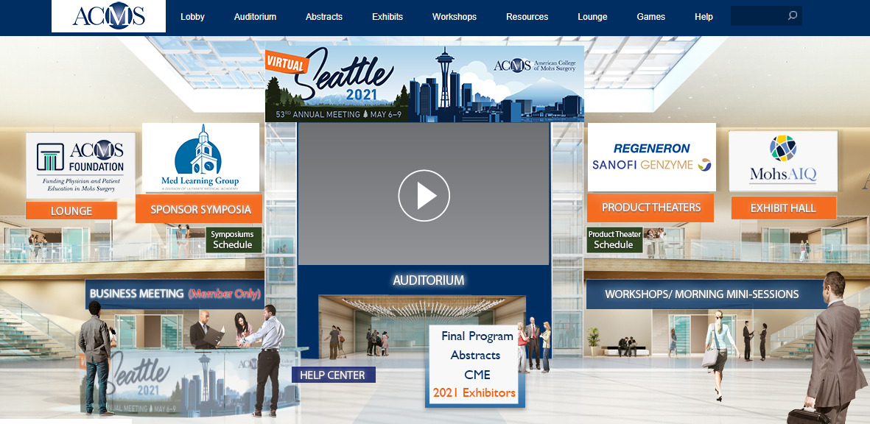
Lobby
After logging into the event, you will be taken into the Lobby area.
From the Lobby, you can visit the main areas of the event by clicking on their listing or utilizing the navigation bar.
1. Search: You can use the search feature to find attendees, sponsors, documents/links and presentations/webcasts within the event.
2. Navigation: Access the different spaces in the event.
3. Lobby: You can return to the lobby by clicking on “Lobby’ on the top toolbar.

Slide 6


Exhibits
By clicking on Exhibits tab on the top navigation, you will be taken to the Exhibits Hall, where you can visit booths, download/view content and engage with booth staff.
Once you’ve entered a booth, you may click through the content tabs on the right-hand side to view collateral and other assets and information provided by the Sponsors.
The sponsor staff listed in the staff tab (click on icon highlighted in red) will be standing by in the space to chat with you and answer your queries.

Slide 7
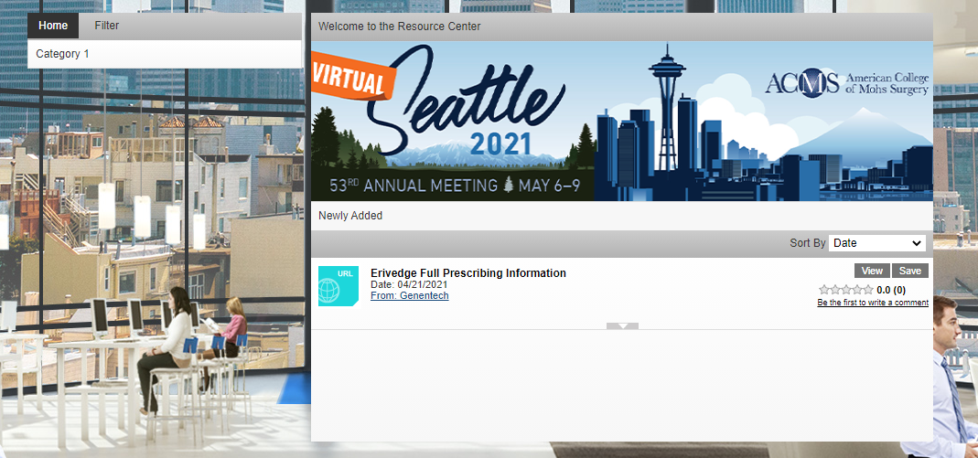
Resources
The Resource Center is your digital library to browse content by subject across the different areas of the event.
Select the content for immediate viewing or save to your briefcase for review or download at your convenience.
Filter: Categorize resources by Event, Sponsors and Spaces.
View/Save: View and/or save a document to your briefcase for review at your convenience.
Briefcase: When Save is selected, the document will be saved to your briefcase. The briefcase can be accessed in your Profile.

Slide 8
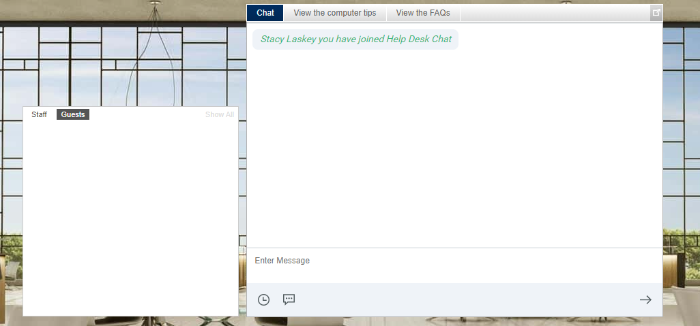
Help Desk
The Help Desk is available for any technical support issues you have while interacting in the virtual event. There are helpful resources available to you such as guides, FAQs, and support documentation to aid in troubleshooting support requests.
Chat: Will allow you to chat with support staff available to help assist with any questions you may have.
Resources: Available to view helpful resources in troubleshooting potential issues such as chat or communication problems, security prompts, FAQs, etc.

Slide 9

Lounge
The Lounge is a great place to communicate and network with attendees, speakers and sponsors.
Join the public chat and network with various staff and guests.
Social Suite allows you to Tweet live and connect with the events Facebook page to share your experience.

Slide 10
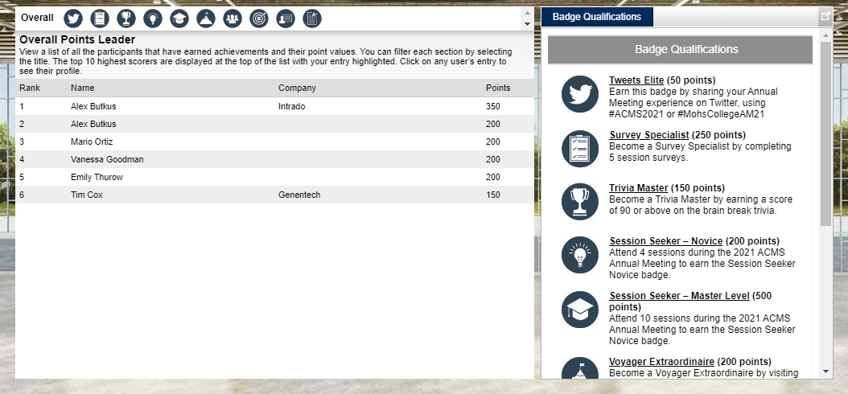
Badge Leaderboard
Here you can view all achievement badges, the top point earners, your points, and participants for each achievement badge.
There are many great ways to achieve points for activity inside the environment through the Achievement Badges.
Badges with assigned point values can be earned by interacting with different event spaces, presentations, attendees and sponsors within the event.

Slide 11

Sounds of the Event
The event uses audio to notify you when certain events occur.
This is especially helpful if you are logged into the event but are working in another application.
Chat Accepted
Communication Received
When someone responds to a chat request that you initiated, you will hear this sound. Click on the icon at the left to play the sound.
You will hear this sound when you receive a new Email, chat request or VCard Click on the icon at the left to play the sound.
Notes:
Update sounds as needed.

Slide 12
Event Support
Live Event Date: | May 5 – 9, 2021
Available On-Demand: | Until May 9, 2022
Login Link: | https://onlinexperiences.com/Launch/Event.htm?ShowKey=146310
www.intrado.com

Slide 13
Thank You

